Slide 1
Relational Model

Slide 2
Relational Model Concepts
The relational Model of Data is based on the concept of a Relation
A Relation is a mathematical concept based on the ideas of sets
The strength of the relational approach to data management comes from the formal foundation provided by the theory of relations.

Slide 3
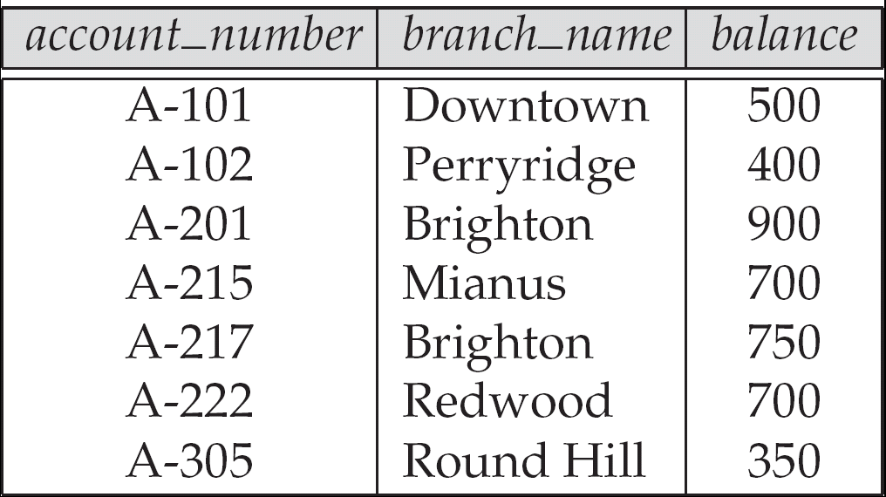
Example of a Relation

Slide 4
Relational Data Structure
Relation
Attribute
Domain
Tuple (extension)
Degree (no. of attributes)
Cardinality (no. of rows)
Relational Database: A collection of normalized relations with distinct relation names

Slide 5
Attribute Types
Each attribute of a relation has a name
The set of allowed values for each attribute is called the domain of the attribute
Attribute values are (normally) required to be atomic; that is, indivisible
E.g. the value of an attribute can be an account number, but cannot be a set of account numbers
Domain is said to be atomic if all its members are atomic
The special value null is a member of every domain

Slide 6
Relation Schemas
Formally, given domains D₁, D₂, …. D_{n} a relation r is a subset of D₁ x D₂ x … x D_{n} Thus, a relation is a set of n-tuples (a₁, a₂, …, a_{n}) where each a_{i} ∈ D_{i}
Schema of a relation consists of
attribute definitions
name
type/domain
integrity constraints

Slide 7
Relation Instance
The current values (relation instance) of a relation are specified by a table
An element t of r is a tuple, represented by a row in a table
Order of tuples is irrelevant
attributes
(or columns)
customer_name
customer_street
customer_city
Jones
Smith
Curry
Lindsay
Main
North
North
Park
Harrison
Rye
Rye
Pittsfield
tuples
(or rows)
customer

Slide 8
Database
A database consists of multiple relations
Information about an enterprise is broken up into parts, with each relation storing one part of the information
E.g.
account : information about accounts
depositor : which customer owns which account
customer : information about customers

Slide 9
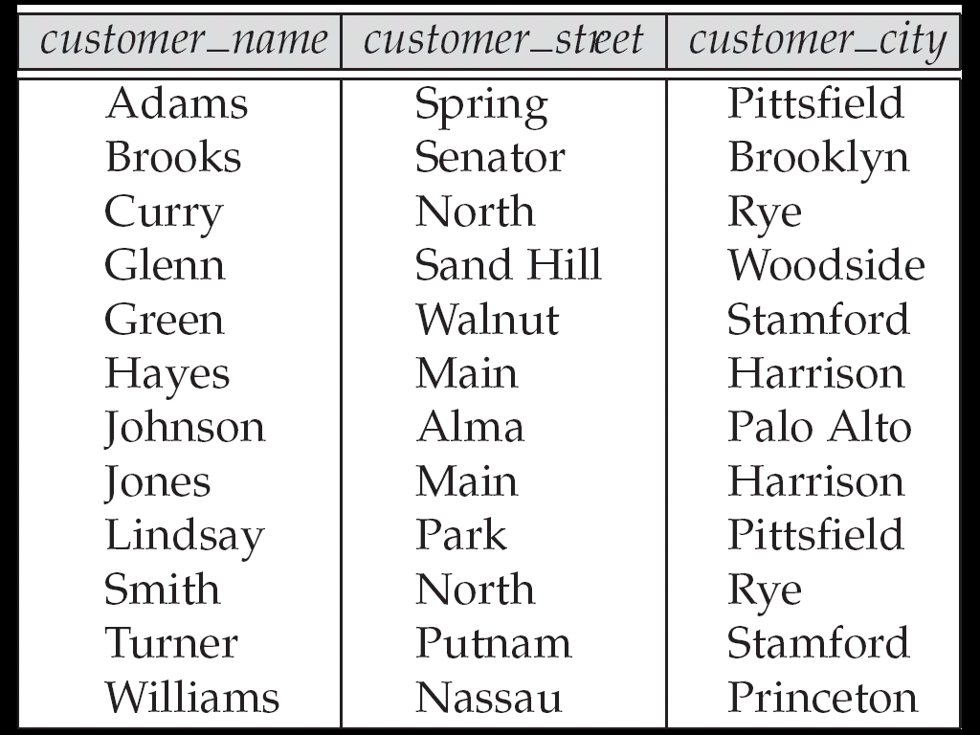
The customer Relation

Slide 10
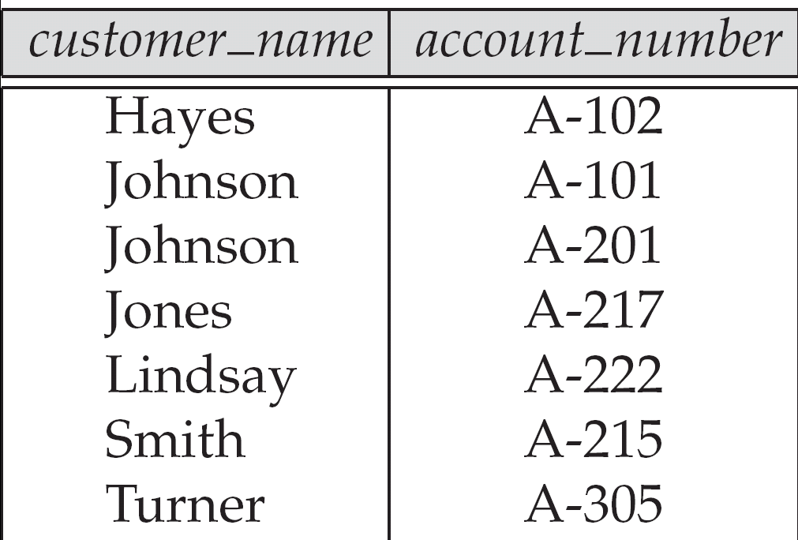
The depositor Relation

Slide 11
Properties of Relation
Relation name is distinct
Each cell of the relation contains exactly one atomic (single) value
Each attribute has a distinct name
The values of an attribute are all from the same domain
Each tuple is distinct (no duplicate tuples)
The order of attributes has no significance
The order of tuple has no significance, theoretically

Slide 12
Why Split Information Across Relations?
Storing all information as a single relation such as bank(account_number, balance, customer_name, ..) results in
repetition of information
e.g.,if two customers own an account
the need for null values
e.g., to represent a customer without an account
Normalization theory deals with how to design relational schemas

Slide 13
Codd's Rules for RDBMS
Dr. Edgar Frank Codd (August 19, 1923 – April 18, 2003) was a computer scientist
He invented the relational model for database management ( theoretical basis for relational databases) while working for IBM
Codd proposed thirteen rules (numbered zero to twelve) and said that
if a Database Management System meets these rules, it can be called as a Relational Database Management System
These rules are called as Codd's12 rules
Hardly any commercial product follows all
Rule Zero
The system must qualify as relational, as a database, and as a management system. For a system to qualify as a relational database management system (RDBMS), that system must use its relational facilities (exclusively) to manage the database.

Slide 14
Remaining 12 CODD’S RULES
Information Rule
Guaranteed Access Rule
Systematic Treatment of Nulls Rule
Active On-line catalog based on the relational model
Comprehensive Data Sub-language Rule
View Updating Rule
High-Level Insert, Update and Delete
Physical Data Independence
Logical Data Independence
Integrity Independence
Distribution Independence
No subversion Rule

Slide 15
CODD’S RULES
Information Rule
The data stored in a database, may it be user data or metadata, must be a value of some table cell
Everything in a database must be stored in a table format
Guaranteed Access Rule
Every single data element (value) is guaranteed to be accessible logically with a combination of table-name, primary-key (row value), and attribute-name (column value)
No other means, such as pointers, can be used to access data

Slide 16
CODD’S RULES
Systematic Treatment of NULL Values
The NULL values in a database must be given a systematic and uniform treatment.
This is a very important rule because a NULL can be interpreted as one the following −
data is missing,
data is not known, or
data is not applicable
Active Online Catalog
The structure description of the entire database must be stored in an online catalog, known as data dictionary, which can be accessed by authorized users
Users can use the same query language to access the catalog which they use to access the database itself

Slide 17
CODD’S RULES
Comprehensive Data Sub-Language Rule
A database can only be accessed using a language having linear syntax that supports data definition, data manipulation, and transaction management operations
This language can be used directly or by means of some application
If the database allows access to data without any help of this language, then it is considered as a violation
View Updating Rule
Different views created for various purposes should be automatically updatable by the system

Slide 18
CODD’S RULES
High level insert, update and delete rule
Relational Model should support insert, delete, update etc. operations at each level of relations
Also, set operations like Union, Intersection and minus should be supported
Physical data independence
Any modification in the physical location of a table should not enforce modification at application level
Logical data independence
Any modification in logical or conceptual schema of a table should not enforce modification at application level
For example, merging of two tables into one should not affect application accessing it which is difficult to achieve

Slide 19
CODD’S RULES
Integrity Independence
Integrity constraints modified at database level should not enforce modification at application level
Distribution Independence
Distribution of data over various locations should not be visible to end-users
Non-Subversion Rule
Low level access to data should not be able to bypass integrity rule to change data

Slide 20
Keys
Let K ⊆ R
K is a superkey of R if values for K are sufficient to identify a unique tuple of each possible relation r(R)
by “possible r ” we mean a relation r that could exist in the enterprise we are modeling.
Example: {customer_name, customer_street} and {customer_name} are both superkeys of Customer, if no two customers can possibly have the same name

Slide 21
Keys (Cont.)
K is a candidate key if K is minimal Example: {customer_name} is a candidate key for Customer, since it is a superkey and no subset of it is a superkey.
Primary key: a candidate key chosen as the principal means of identifying tuples within a relation
Should choose an attribute whose value never, or very rarely, changes.
E.g. email address is unique, but may change

Slide 22
Foreign Keys
A relation schema may have an attribute that corresponds to the primary key of another relation. The attribute is called a foreign key.
E.g. customer_name and account_number attributes of depositor are foreign keys to customer and account respectively.
Only values occurring in the primary key attribute of the referenced relation may occur in the foreign key attribute of the referencing relation.

Slide 23
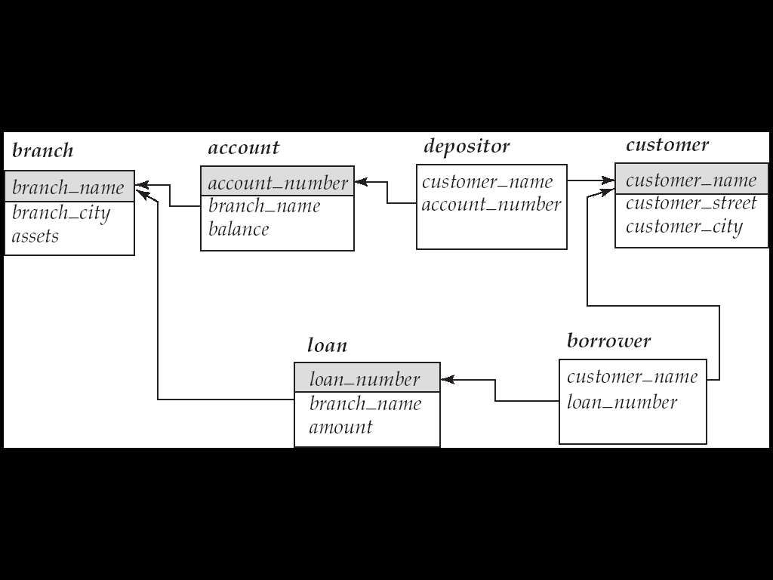
Schema Diagram

Slide 24
Entity Integrity
Relational Database Schema: A set S of relation schemas that belong to the same database. S is the name of the database.
S = {R1, R2, ..., Rn}
Entity Integrity:
The primary key attributes PK of each relation schema R in S cannot have null values in any tuple of r(R)
This is because primary key values are used to identify the individual tuples
t[PK]≠ null for any tuple t in r(R)

Slide 25
Referential Integrity
A constraint involving two relations (entities)(the previous constraints involve a single relation).
Used to specify a relationship among tuples in two relations:
the referencing relation and
the referenced relation
Tuples in the referencing relation R1 have attributes FK (called foreign key attributes) that reference the primary key attributes PK of the referenced relation R2
A tuple t1 in R1 is said to reference a tuple t2 in R2 if
t1[FK] = t2[PK].
A referential integrity constraint can be displayed in a relational database schema as a directed arc from R1(FK) to R2.

Slide 26
Referential Integrity Constraint
The value in the foreign key column (or columns) FK of the the referencing relation R₁ can be either:
(1) a value of an existing primary key value of the corresponding primary key PK in the referenced relation R_{2,}, or..
(2) a null
In case (2), the FK in R₁ should not be a part of its own primary key

Slide 27
Enterprise Constraints
Definition: Additional rules specified by the user or database administrators of a database.
Examples:
Each branch office has at most 20 staff
Expenditure of each department should not exceeds above Rs. 1,00,000

Slide 28
Views
Base Relation
View
Purpose of Views

Slide 29
Query Languages
Language in which user requests information from the database
Categories of languages
Procedural
Non-procedural, or declarative
“Pure” languages:
Relational algebra
Tuple relational calculus
Domain relational calculus
Pure languages form underlying basis of query languages that people use

Slide 30
Relational Algebra
Procedural language
Six basic operators
select: σ
project: ∏
union: ∪
set difference: –
Cartesian product: x
rename: ρ
The operators take one or two relations as inputs and produce a new relation as a result

Slide 31
Select Operation – Example
Relation r
A
B
C
D
α
α
β
β
α
β
β
β
1
5
12
23
7
7
3
10
σ_{A=B ^ D > 5} (r)
A
B
C
D
α
β
α
β
1
23
7
10

Slide 32
Project Operation – Example
A
B
C
Relation r:
α
α
β
β
10
20
30
40
1
1
1
2
A
C
A
C
∏_{A,C} (r)
α
α
β
β
1
1
1
2
α
β
β
1
1
2
=

Slide 33
Union Operation – Example
Relations r, s:
A
B
A
B
α
α
β
1
2
1
α
β
2
3
s
r
A
B
α
α
β
β
1
2
1
3
r ∪ s:

Slide 34
Set Difference Operation – Example
Relations r, s:
A
B
A
B
α
α
β
1
2
1
α
β
2
3
s
r
r – s:
A
B
α
β
1
1

Slide 35
Cartesian-Product Operation –Example
Relations r, s:
A
B
C
D
E
α
β
1
2
α
β
β
γ
10
10
20
10
a
a
b
b
r
s
r x s:
A
B
C
D
E
α
α
α
α
β
β
β
β
1
1
1
1
2
2
2
2
α
β
β
γ
α
β
β
γ
10
10
20
10
10
10
20
10
a
a
b
b
a
a
b
b

Slide 36
Rename Operation
Allows us to name, and therefore to refer to, the results of relational-algebra expressions.
Allows us to refer to a relation by more than one name.
Example:
ρ _{x} (E) returns the expression E under the name X
If a relational-algebra expression E has arity n, then returns the result of expression E under the name X, and with the attributes renamed to A₁ , A₂ , …., A_{n} .

Slide 37
Composition of Operations
Can build expressions using multiple operations
Example: σ_{A=C}(r x s)
r x s
σ_{A=C}(r x s)
A
B
C
D
E
α
α
α
α
β
β
β
β
1
1
1
1
2
2
2
2
α
β
β
γ α
β
β
γ
10
10
20
10
10
10
20
10
a
a
b
b
a
a
b
b
A
B
C
D
E
α
β
β
1
2
2
α
β
β
10
10
20
a
a
b

Slide 38
Banking Example
branch (branch_name, branch_city, assets)
customer (customer_name, customer_street, customer_city)
account (account_number, branch_name, balance)
loan (loan_number, branch_name, amount)
depositor (customer_name, account_number)
borrower (customer_name, loan_number)

Slide 39
Example Queries
Find all loans of over $1200
σ_{amount > 1200} (loan)
Find the loan number for each loan of an amount greater than $1200
∏_{loan_number} (σ_{amount} _{> 1200} (loan))
Find the names of all customers who have a loan, an account, or both, from the bank
∏_{customer_name} (borrower) ∪ ∏_{customer_name} (depositor)

Slide 40
Example Queries
Find the names of all customers who have a loan at the Perryridge branch.
∏_{customer_name} (σ_{branch_name=“Perryridge”}
(σborrower.loan_number = loan.loan_number(borrower x loan)))
Find the names of all customers who have a loan at the Perryridge branch but do not have an account at any branch of the bank.
∏_{customer_name} (σ_{branch_name = “Perryridge”}
(σborrower.loan_number = loan.loan_number(borrower x loan))) – ∏_{customer_name}(depositor)

Slide 41
Example Queries
Find the names of all customers who have a loan at the Perryridge branch.
∏_{customer_name} (σ_{branch_name = “Perryridge”} ( σborrower.loan_number = loan.loan_number (borrower x loan)))
∏_{customer_name}(σloan.loan_number = borrower.loan_number ( (σ_{branch_name = “Perryridge”} (loan)) x borrower))

Slide 42
Additional Operations
Additional Operations
Set intersection
Natural join
Aggregation
Outer Join
Division
All above, other than aggregation, can be expressed using basic operations we have seen earlier

Slide 43
Set-Intersection Operation – Example
Relation r, s:
r ∩ s:
A B
A B
α
α
β
1
2
1
α
β
2
3
r
s
A B
α 2

Slide 44
Natural-Join Operation
Notation: r s
Let r and s be relations on schemas R and S respectively. Then, r s is a relation on schema R ∪ S obtained as follows:
Consider each pair of tuples t_{r} from r and t_{s} from s.
If t_{r} and t_{s} have the same value on each of the attributes in R ∩ S, add a tuple t to the result, where
t has the same value as t_{r} on r
t has the same value as t_{s} on s
Example:
R = (A, B, C, D)
S = (E, B, D)
Result schema = (A, B, C, D, E)
r s is defined as: ∏_{r.A, r.B, r.C, r.D, s.E} (σ_{r.B = s.B} ∧ _{r.D = s.D} (r x s))

Slide 45
Natural Join Operation – Example
Relations r, s:
A
B
C
D
B
D
E
α
β
γ
α
δ
1
2
4
1
2
α
γ
β
γ
β
a
a
b
a
b
1
3
1
2
3
a
a
a
b
b
α
β
γ
δ
∈
r
s
r s
A
B
C
D
E
α
α
α
α
δ
1
1
1
1
2
α
α
γ
γ
β
a
a
a
a
b
α
γ
α
γ
δ

Slide 46
Bank Example Queries
Find the largest account balance
Strategy:
Find those balances that are not the largest
Rename account relation as d so that we can compare each account balance with all others
Use set difference to find those account balances that were not found in the earlier step.
The query is:
∏_{balance}(account) - ∏_{account.balance}
(σ_{account.balance < d.balance} (account x ρ_{d} (account)))

Slide 47
Aggregate Functions and Operations
Aggregation function takes a collection of values and returns a single value as a result.
avg: average value min: minimum value max: maximum value sum: sum of values count: number of values
Aggregate operation in relational algebra
E is any relational-algebra expression
G₁, G₂ …, G_{n} is a list of attributes on which to group (can be empty)
Each F_{i} is an aggregate function
Each A_{i} is an attribute name

Slide 48
Aggregate Operation – Example
Relation r:
A
B
C
α
α
β
β
α
β
β
β
7
7
3
10
g _{sum(c)} (r)
sum(c )
27

Slide 49
Aggregate Operation – Example
Relation account grouped by branch-name:
branch_name
account_number
balance
Perryridge
Perryridge
Brighton
Brighton
Redwood
A-102
A-201
A-217
A-215
A-222
400
900
750
750
700
_{branch_name} g _{sum(balance)} (account)
branch_name
sum(balance)
Perryridge
Brighton
Redwood
1300
1500
700

Slide 50
Aggregate Functions (Cont.)
Result of aggregation does not have a name
Can use rename operation to give it a name
For convenience, we permit renaming as part of aggregate operation
_{branch_name} g _{sum(balance) as sum_balance} (account)

Slide 51
Outer Join
An extension of the join operation that avoids loss of information.
Computes the join and then adds tuples form one relation that does not match tuples in the other relation to the result of the join.
Uses null values:
null signifies that the value is unknown or does not exist
All comparisons involving null are (roughly speaking) false by definition.
We shall study precise meaning of comparisons with nulls later

Slide 52
Outer Join – Example
Relation loan
loan_number
branch_name
amount
L-170
L-230
L-260
Downtown
Redwood
Perryridge
3000
4000
1700
Relation borrower
customer_name
loan_number
Jones
Smith
Hayes
L-170
L-230
L-155

Slide 53
Outer Join – Example
Join loan borrower
loan_number
branch_name
amount
customer_name
L-170
L-230
Downtown
Redwood
3000
4000
Jones
Smith
Left Outer Join
loan borrower
loan_number
branch_name
amount
customer_name
L-170
L-230
L-260
Downtown
Redwood
Perryridge
3000
4000
1700
Jones
Smith
null

Slide 54
Outer Join – Example
Right Outer Join
loan borrower
loan_number
branch_name
amount
customer_name
L-170
L-230
L-155
Downtown
Redwood
null
3000
4000
null
Jones
Smith
Hayes
Full Outer Join
loan borrower
loan_number
branch_name
amount
customer_name
L-170
L-230
L-260
L-155
Downtown
Redwood
Perryridge
null
3000
4000
1700
null
Jones
Smith
null
Hayes

Slide 55
Division Operation
Notation:
Suited to queries that include the phrase “for all”.
Let r and s be relations on schemas R and S respectively where
R = (A₁, …, A_{m} , B₁, …, B_{n} )
S = (B₁, …, B_{n})
The result of r ÷ s is a relation on schema
R – S = (A₁, …, A_{m})
r ÷ s = { t | t ∈ ∏ _{R-S} (r) ∧ ∀ u ∈ s ( tu ∈ r ) }
Where tu means the concatenation of tuples t and u to produce a single tuple
r ÷ s

Slide 56
Division Operation – Example
Relations r, s:
A
B
B
α
α
α
β
γ
δ
δ
δ
∈
∈
β
1
2
3
1
1
1
3
4
6
1
2
1
2
s
r ÷ s:
A
r
α
β

Slide 57
Another Division Example
Relations r, s:
A
B
C
D
E
D
E
α
α
α
β
β
γ
γ
γ
a
a
a
a
a
a
a
a
α
γ
γ
γ
γ
γ
γ
β
a
a
b
a
b
a
b
b
1
1
1
1
3
1
1
1
a
b
1
1
s
r
r ÷ s:
A
B
C
α
γ
a
a
γ
γ

Slide 58
Examples of Division A/B
B1
B2
B3
A
A/B1
A/B2
A/B3
Notes:
14

Slide 59
Bank Example Queries
Find all customers who have an account at all branches located in Brooklyn city.
∏_{customer_name, branch_name} (depositor account) ÷ ∏_{branch_name} (σ_{branch_city = “Brooklyn”} (branch))

Slide 60
Assignment Operation
The assignment operation (←) provides a convenient way to express complex queries.
Write query as a sequential program consisting of
a series of assignments
followed by an expression whose value is displayed as a result of the query.
Assignment must always be made to a temporary relation variable.
Example: Write r ÷ s as
temp1 ← ∏_{R-S} (r ) temp2 ← ∏_{R-S} ((temp1 x s ) – ∏_{R-S,S} (r )) result = temp1 – temp2
The result to the right of the ← is assigned to the relation variable on the left of the ←.
May use variable in subsequent expressions.

Slide 61
Modification of the Database
The content of the database may be modified using the following operations:
Deletion
Insertion
Updating
All these operations are expressed using the assignment operator.

Slide 62
Deletion
A delete request is expressed similarly to a query, except instead of displaying tuples to the user, the selected tuples are removed from the database.
Can delete only whole tuples; cannot delete values on only particular attributes
A deletion is expressed in relational algebra by:
r ← r – E
where r is a relation and E is a relational algebra query.

Slide 63
Deletion Examples
Delete all account records in the Perryridge branch.
account ← account – σ _{branch_name = “Perryridge”} (account )
Delete all loan records with amount in the range of 0 to 50
loan ← loan – σ _{amount ≥ 0 and amount ≤ 50} (loan)
Delete all accounts at branches located in Needham.
r₁ ← σ _{branch_city = “Needham”} (account branch )
r₂ ← ∏ _{account_number,} _{branch_name, balance} (r₁)
r₃ ← ∏ _{customer_name, account_number} (r₂ depositor)
account ← account – r₂
depositor ← depositor – r₃

Slide 64
Insertion
To insert data into a relation, we either:
specify a tuple to be inserted
write a query whose result is a set of tuples to be inserted
In relational algebra, an insertion is expressed by:
r ← r ∪ E
where r is a relation and E is a relational algebra expression.
The insertion of a single tuple is expressed by letting E be a constant relation containing one tuple.

Slide 65
Insertion Examples
Insert information in the database specifying that Smith has $1200 in account A-973 at the Perryridge branch.
account ← account ∪ {(“A-973”, “Perryridge”, 1200)}
depositor ← depositor ∪ {(“Smith”, “A-973”)}
Provide as a gift for all loan customers in the Perryridge branch, a $200 savings account. Let the loan number serve as the account number for the new savings account.
r₁ ← (σ_{branch_name = “Perryridge”} (borrower loan))
account ← account ∪ ∏_{loan_number, branch_name, 200} (r₁)
depositor ← depositor ∪ ∏_{customer_name, loan_number} (r₁)

Slide 66
Updating
A mechanism to change a value in a tuple without charging all values in the tuple
Use the generalized projection operator to do this task
Each F_{i} is either
the I ^{th} attribute of r, if the I ^{th} attribute is not updated, or,
if the attribute is to be updated F_{i} is an expression, involving only constants and the attributes of r, which gives the new value for the attribute

Slide 67
Update Examples
Make interest payments by increasing all balances by 5 percent.
account ← ∏ account_number, branch_name, balance * 1.05 (account)
Pay all accounts with balances over $10,000 6 percent interest and pay all others 5 percent
account ← ∏ account_number, branch_name, balance * 1.06 (σ _{BAL > 10000} (account )) ∪ ∏ account_number, branch_name, balance * 1.05 (σ_{BAL ≤ 10000} (account))

Slide 68
Null Values
It is possible for tuples to have a null value, denoted by null, for some of their attributes
null signifies an unknown value or that a value does not exist.
The result of any arithmetic expression involving null is null.
Aggregate functions simply ignore null values
For duplicate elimination and grouping, null is treated like any other value, and two nulls are assumed to be the same (as in SQL)

Slide 69
Null Values
Comparisons with null values return the special truth value: unknown
If false was used instead of unknown, then not (A < 5) would not be equivalent to A >= 5
Three-valued logic using the truth value unknown:
OR: (unknown or true) = true, (unknown or false) = unknown (unknown or unknown) = unknown
AND: (true and unknown) = unknown, (false and unknown) = false, (unknown and unknown) = unknown
NOT: (not unknown) = unknown
In SQL “P is unknown” evaluates to true if predicate P evaluates to unknown
Result of select predicate is treated as false if it evaluates to unknown

Slide 70
Bank Example Queries
Find the names of all customers who have a loan and an account at bank.
∏_{customer_name} (borrower) ∩ ∏_{customer_name} (depositor)
Find the name of all customers who have a loan at the bank and the loan amount
∏customer_name, loan_number, amount (borrower loan)

Slide 71
Bank Example Queries
Find all customers who have an account from at least the “Downtown” and the Uptown” branches.
Query 1
∏_{customer_name} (σ_{branch_name = “Downtown”} (depositor account )) ∩
∏_{customer_name} (σ_{branch_name = “Uptown”} (depositor account))
Query 2
∏_{customer_name, branch_name} (depositor account) ÷ ρ_{temp(branch_name)} ({(“Downtown” ), (“Uptown” )})
Note that Query 2 uses a constant relation.

